Slide 1
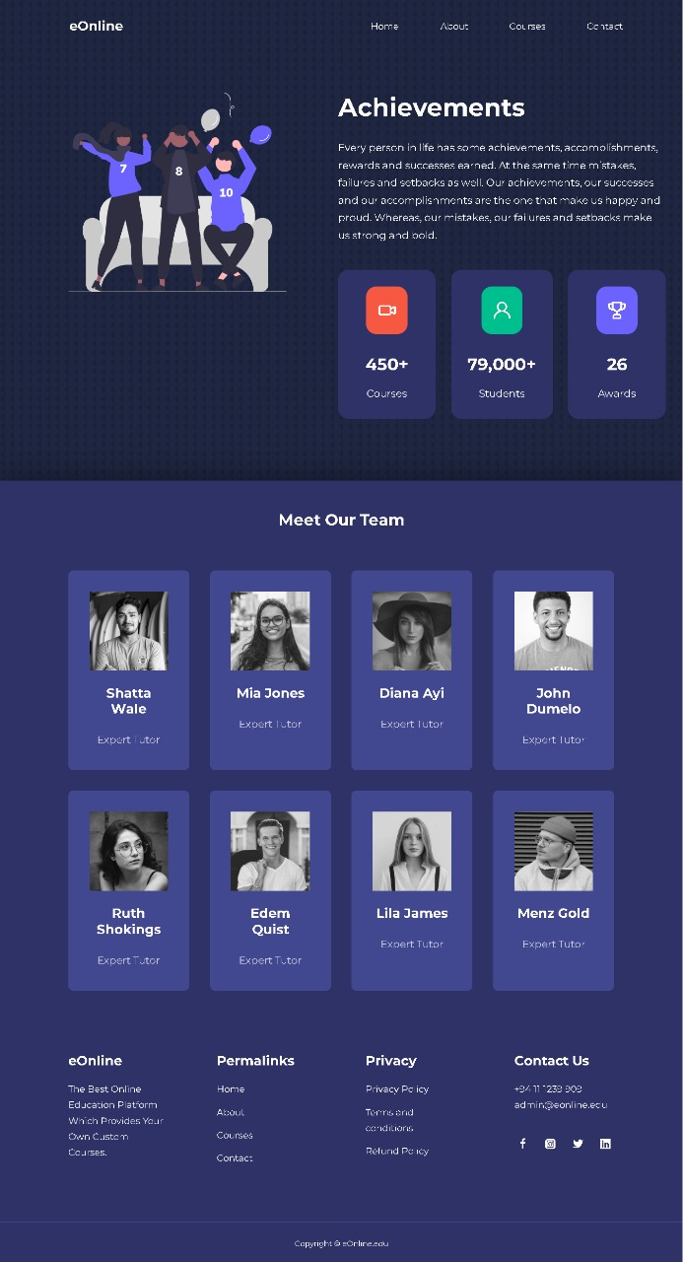
ABOUT PAGE

Slide 2
WORKLOAD DIVISION PLAN
Home – Kasun Jayasanka
Courses – Mihiliya Maheshika
About us – Malintha Kavinda
Contact – Amasha Shivoni

